Slide 1

HEP-Frame A Software Engineered Framework to Aid the Development & Efficient Multicore Execution of Scientific Code
André Pereira
António Onofre
Alberto Proença

Slide 2

Presented in Las Vegas (Dec 9)

Slide 3
Agenda
Motivation
Presenting HEP-Frame (Highly Efficient Pipeline Framework)
HEP-Frame with a Real World Case Study
Conclusions and Future Work

Slide 4
Motivation (1)
The development of efficient scientific code requires techniques from
High Performance Computing: to process data in the least time possible
High Throughput Computing: to process more data per time unit
To achieve this goal we need
Knowledge from the scientific/engineering domain
Clear definition of the application requirements
Efficiency-centered design of algorithms and data structures

Slide 5
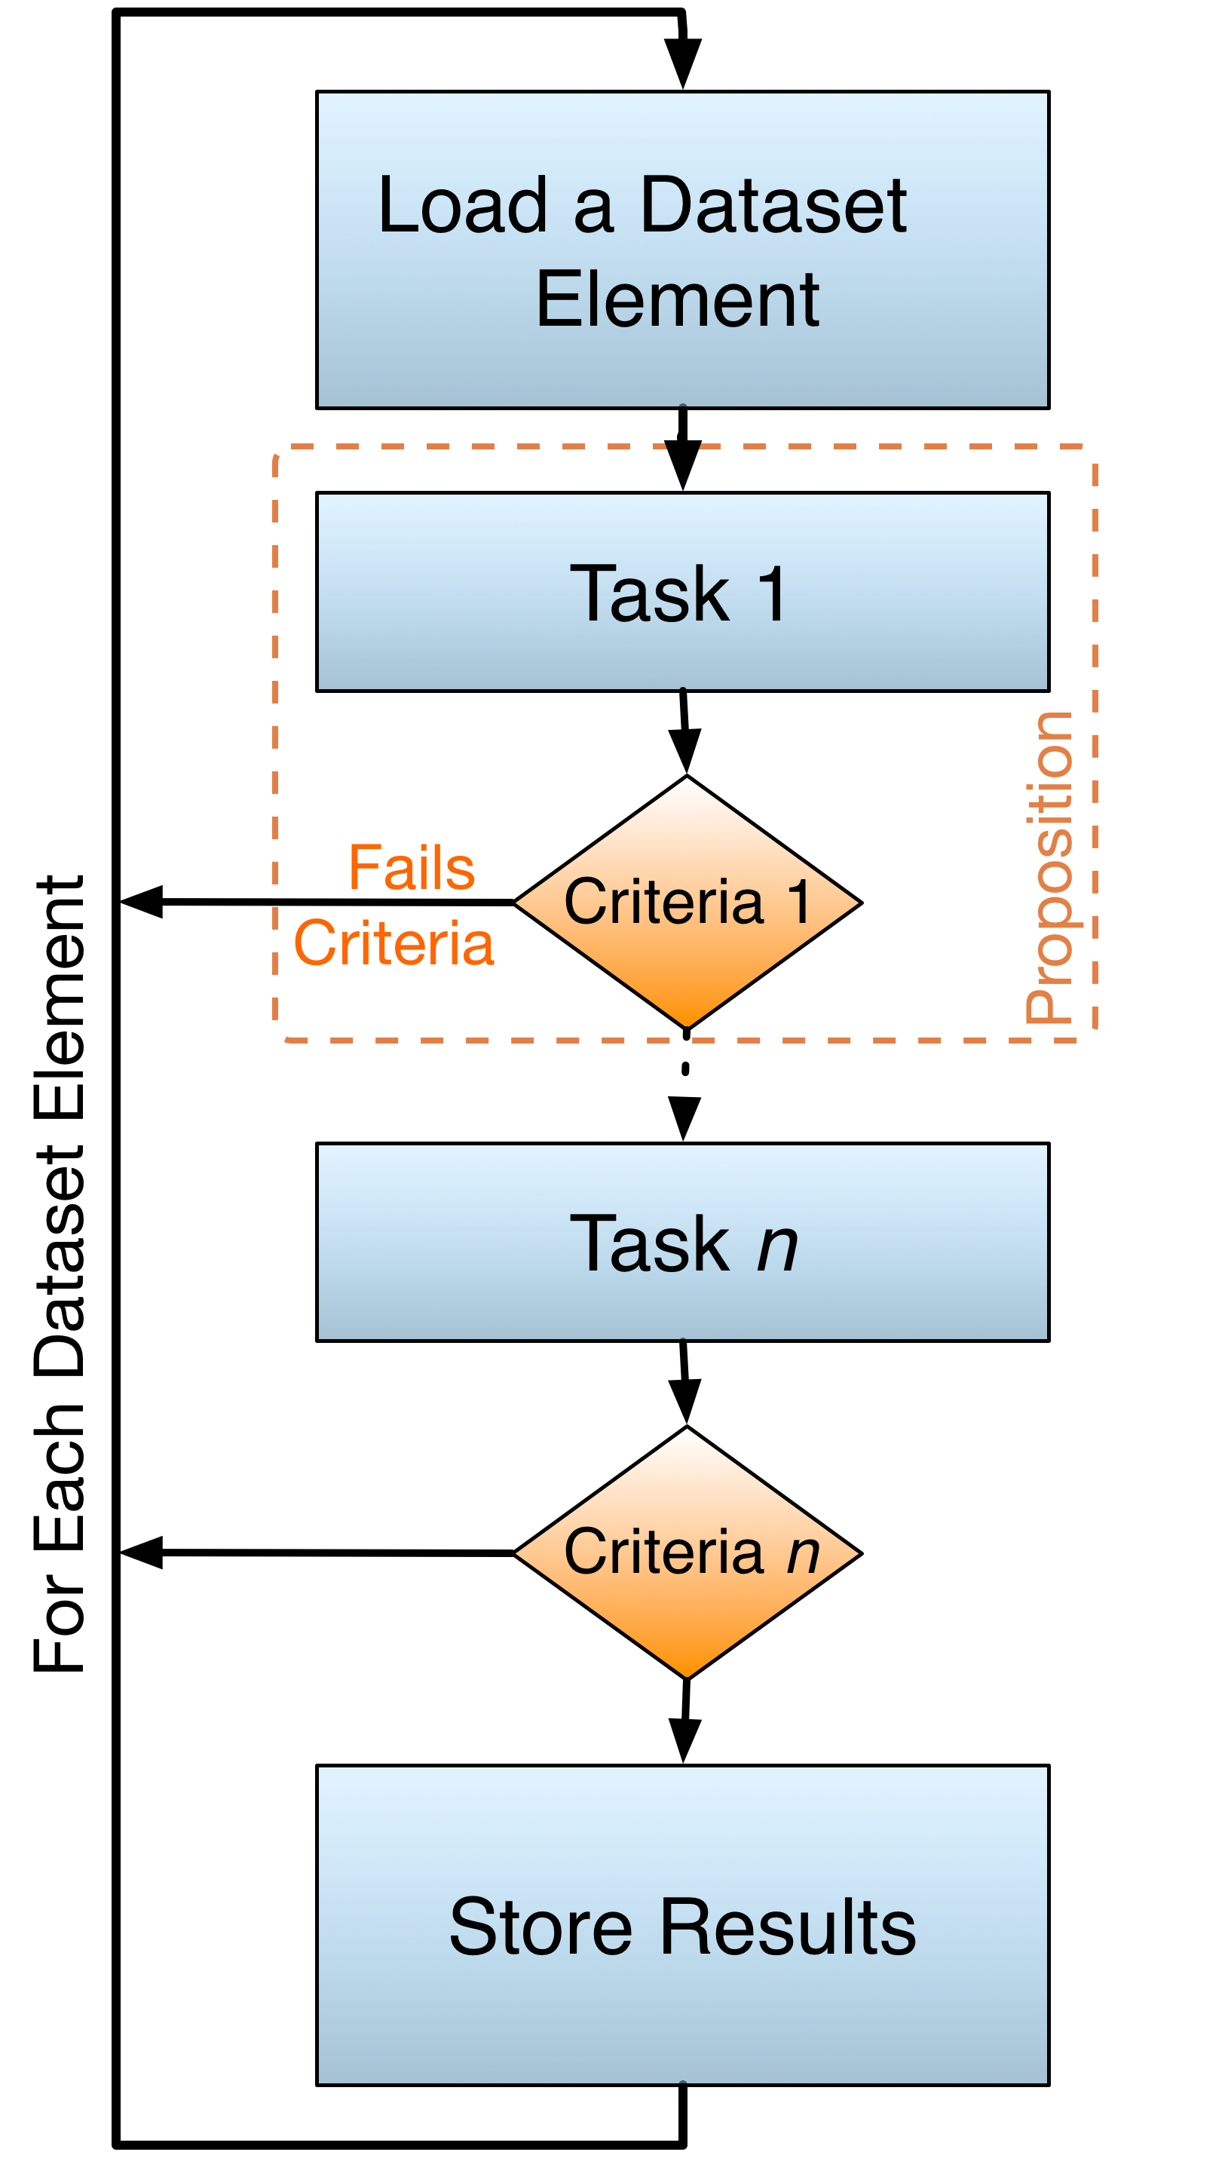
Motivation (2)
Structure of scientific applications (our view)
Handle independent datasets
Execute a chain of tasks (a pipeline)
Each task execution may depend on other(s)
Real world examples
Modeling/simulation
Quantitative data analysis

Slide 6
Motivation (3)
Computational Scientist
Expert in the requirements of a scientific field
Limited knowledge on sustainable parallel code
Software Engineer
Expert on code design and development
Limited knowledge on the end user domain and requirements
Notes:
orientador de cada extremo, eu no meio

Slide 7
HEP-Frame
A move from a resource-centered to a user-centered framework
Aiming to aid the development of sustainable parallel pipelined code
Key goals:
To provide an user-friendly interface, hiding from the end user hardware details
To bet on performance with an hybrid HPC/HTC approach, addressing issues of compute, memory and I/O bound applications
To dynamically address efficiency issues across different computing platforms, adapting features from the best resource-centered frameworks (undergoing...)

Slide 8
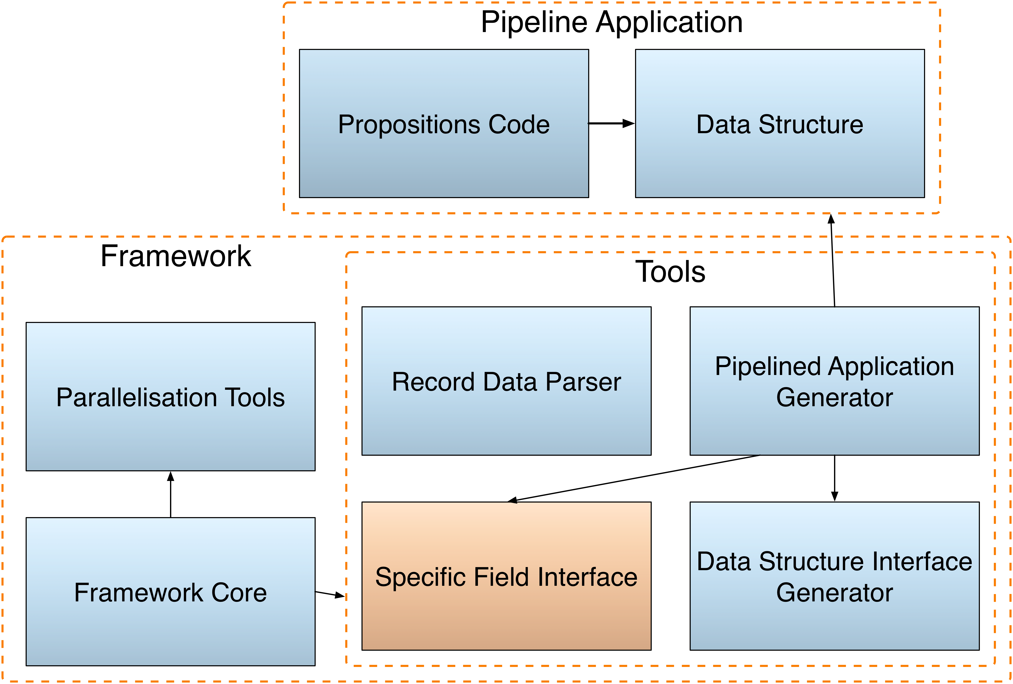
HEP-Frame Design (1)
To aid code development (compile time)
Providing an user-friendly interface
Implementing app specific features
Coding abstractions
To aid efficient code execution (runtime)
Single core automatic optimizations
Shared memory automatic parallelization (current prototype)

Slide 9
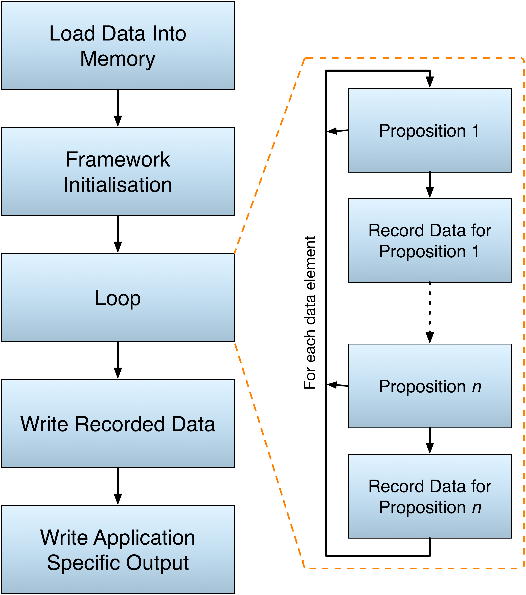
HEP-Frame Design (2)
To aid code development (compile time)
Providing an user friendly interface
Implementing app specific features
Coding abstractions
To aid efficient code execution (runtime)
Single core automatic optimizations
Shared memory automatic parallelization (current prototype)

Slide 10
HEP-Frame Efficiency Features (1)
Inter-dataset optimizations (aiming HTC)
Replicate pipeline to process independent dataset elements
Use OpenMP with dynamic scheduler (suited for irregular workloads)
Balance/mix processes with threads (research undergoing)

Slide 11
HEP-Frame Efficiency Features (2)
Intra-dataset optimizations (aiming HPC)
Removal of algorithmic and data structures inefficiencies
Exploring the parallel hardware at each core (ILP, SIMD, ...)
Adequate ordering of the pipeline tasks
Pipeline can be described with Linear Temporal Logic
FGP₁ ∧ FGP₂ ∧ ... ∧ FGP_{n}
If proposition P₂ depends on P₁
F GP_{n} ∧...∧F G(P₁ ∧F GP₂ )

Slide 12
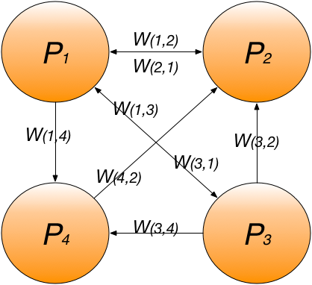
HEP-Frame Efficiency Features (3)
Pipeline reorganization mechanism
Propositions execution time
Propositions filtering ratio
Graph of propositions
Dependencies represented as “infinite” weight
Best order is a path through all propositions that minimizes the overall weight
Hamiltonian Path (NP-Complete) with simplifications
proposition weight

Slide 13
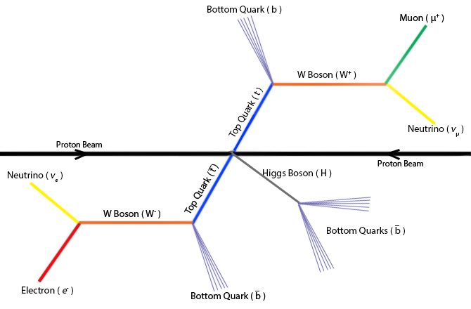
Real World Case Study (1)
A particle physics data analysis
Developed by CERN physicists of the ATLAS Experiment
Studies the couplings of top quarks to the Higgs boson (ttHdilep)
Computational characteristics
17 simple propositions to filter non complying data
1 heavy proposition that reconstructs the collision

Slide 14
Real World Case Study (2)
Report on porting (by a physicist)
15-minute crash course
4 hours to port an implementation
Changes to the framework did not require updating the physicist code
Final framework learning curve no longer than 30 minutes

Slide 15
Execution Times with HEP-Frame
Intel Xeon | E5520 | X5650 | E5-2650v2 | E5-2670v2 | E5-2695v2
Key data | 2x4 cores @2.27GHz | 2x6 cores @2.67GHz | 2x8 cores @2.6GHz | 2x10 cores @2.5GHz | 2x12 cores @2.4GHz
Sequential Exec. Time (s) | 215 | 196 | 175 | 180 | 183
Parallel Exec. Time (s) | 45 | 30 | 23 | 22 | 23
Execution of the ttHdilep code
Distinct compute nodes in a cluster, all with dual Xeons
Parallel version: one single process using all available cores, no SMT
Computing accelerators (GPU, Intel MIC): under development

Slide 16
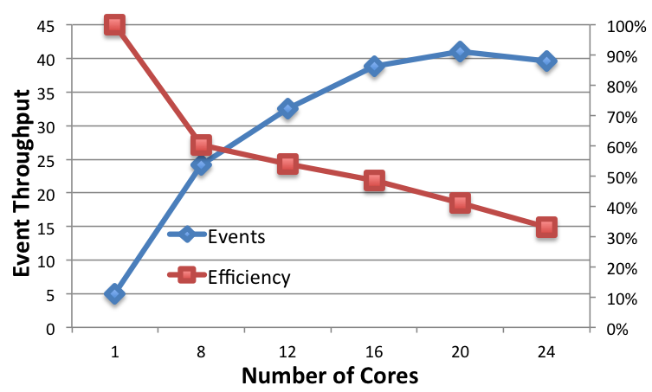
HEP-Frame Efficiency
Comments on this plot
“Number of Cores”: max available cores at the compute node
1-core: reference sequential throughput
Previous code improvements (without HEP-Frame) achieved speedup <8 for 20 cores
Low performance due to thread synchronization and I/O inefficiencies
Notes:
general rules

Slide 17
HEP-Frame Pipeline Reorganization
Initial Order | 1 | 2 | 3 | 4 | 5 | 6 | 7 | 8 | 9 | 10 | 11 | 12 | 13 | 14 | 15 | 16 | 17 | 18 | Total Time
Exec. Time (ms) | 37113 | 1,03 | 0,70 | 1,53 | 0,97 | 8,04 | 0,48 | 5,13 | 0,43 | 5,60 | 0,44 | 1,35 | 0,40 | 0,53 | 0,28 | 0,38 | 0,56 | 91055 | 175 s
Element Pass % | 100 | 100 | 100 | 100 | 50,4 | 99,9 | 100 | 100 | 100 | 100 | 99,7 | 94,9 | 99,5 | 99,9 | 99,2 | 100 | 63,4 | 100
Reorder Result | 5 | 17 | 12 | 15 | 13 | 11 | 14 | 6 | 16 | 1 | 2 | 3 | 4 | 7 | 8 | 9 | 10 | 18
Exec. Time (ms) | 0,97 | 0,60 | 0,86 | 0,18 | 0,25 | 0,26 | 0,33 | 4,76 | 0,24 | 2111,9 | 0,31 | 0,21 | 0,45 | 0,28 | 3,03 | 0,26 | 3,31 | 91033 | 101 s
Reordering at runtime
70% performance improvement
Reduces the amount of variables recorded per proposition
The algorithm requires some time to converge

Slide 18
Conclusions
HEP-Frame eases the development of sustainable parallel code
Provides a user-friendly interface
Addresses execution efficiency issues transparently from the user
Small learning curve for Computational Scientists
ttHdilep port to HEP-Frame achieved a speedup of 8x for a 20-core system
Using a general heuristic for pipeline applications, rather than tailored optimizations
Efficiency still limited by synchronization and I/O
Pipeline reorganization improved the execution time of ttHdilep by 70%

Slide 19
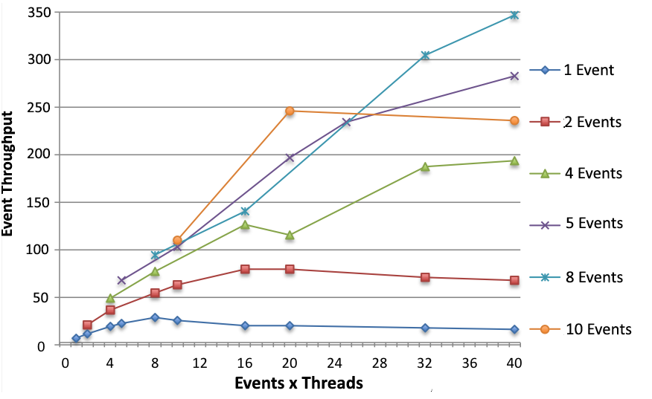
Key Topics for Future Work
Improve the reorder mechanism
To make it converge faster
To reduce its overhead
Improve efficiency with hybrid HTC/HPC
Hybrid multiprocess/multithread parallelization (first prototype recently completed)
Automatic offload of compute intensive propositions to computing accelerators

Slide 20
HEP-Frame ?
ampereira@di.uminho.pt

